Slide 1
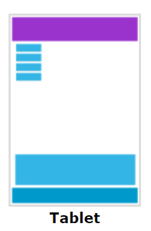
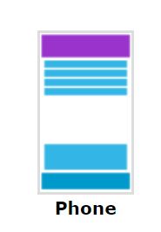
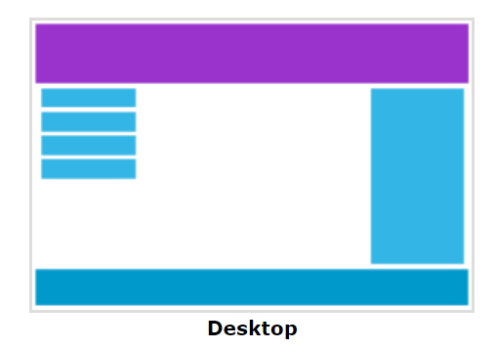
Responsive
N.B: Designing For The Best Experience For All Users

Slide 2
Extra Large Device: 1200px –To High
Large Device PC: 992px (Min)-1199.98 (Max)
Tab Or Medium: 768 (Min) - 991px(Max)
SmartPhone : 576px (Min) - 767.98px (Max)
Xmd- 0 (Min) - max-width: 575px

